Slide 1
General License Course Chapter 3.1
Regulatory Agencies

Slide 2
International Telecommunications Union
ITU is the organization responsible for all international radio regulations
Radio knows no geographical boundaries
Each nation agrees by treaty to abide by those regulations
Each country decides how to administer and implement those regulations (This is the role of the FCC in the USA)

Slide 3
FCC Structure and Authority
The Federal Communications Committee (FCC) was established by the Communications Act of 1934
Regulates interstate and international communications by radio, television, wire, satellite and cable
FCC jurisdiction covers the 50 states, District of Columbia, U.S. possessions and territories, and USA-flagged vessels

Slide 4
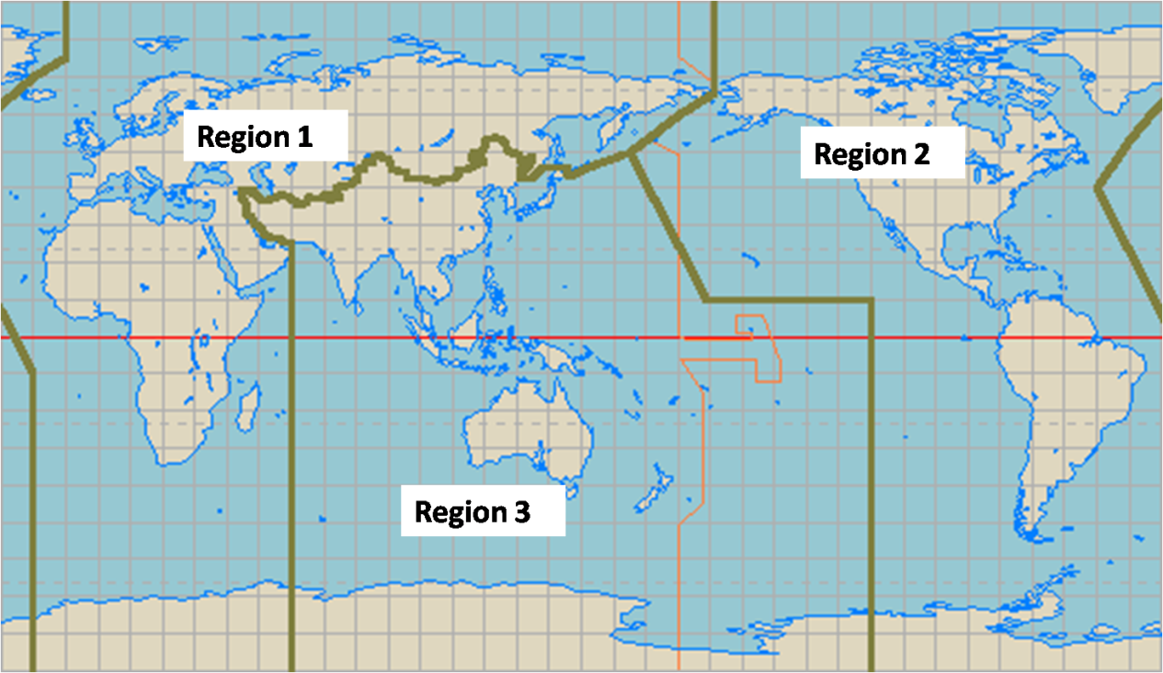

ITU
The world is divided into 3 ITU regions
North and South America are in Region 2
Different ITU regions have different frequency privileges.
FCC-licensed amateurs may have different frequency allocations when operating outside Region 2

Slide 5
Remote Operation
When operating a US station via remote control the control operator must hold a US operator/primary station license
When operating a station in another country via
remote control the regulations of the remote
station’s country apply

Slide 6
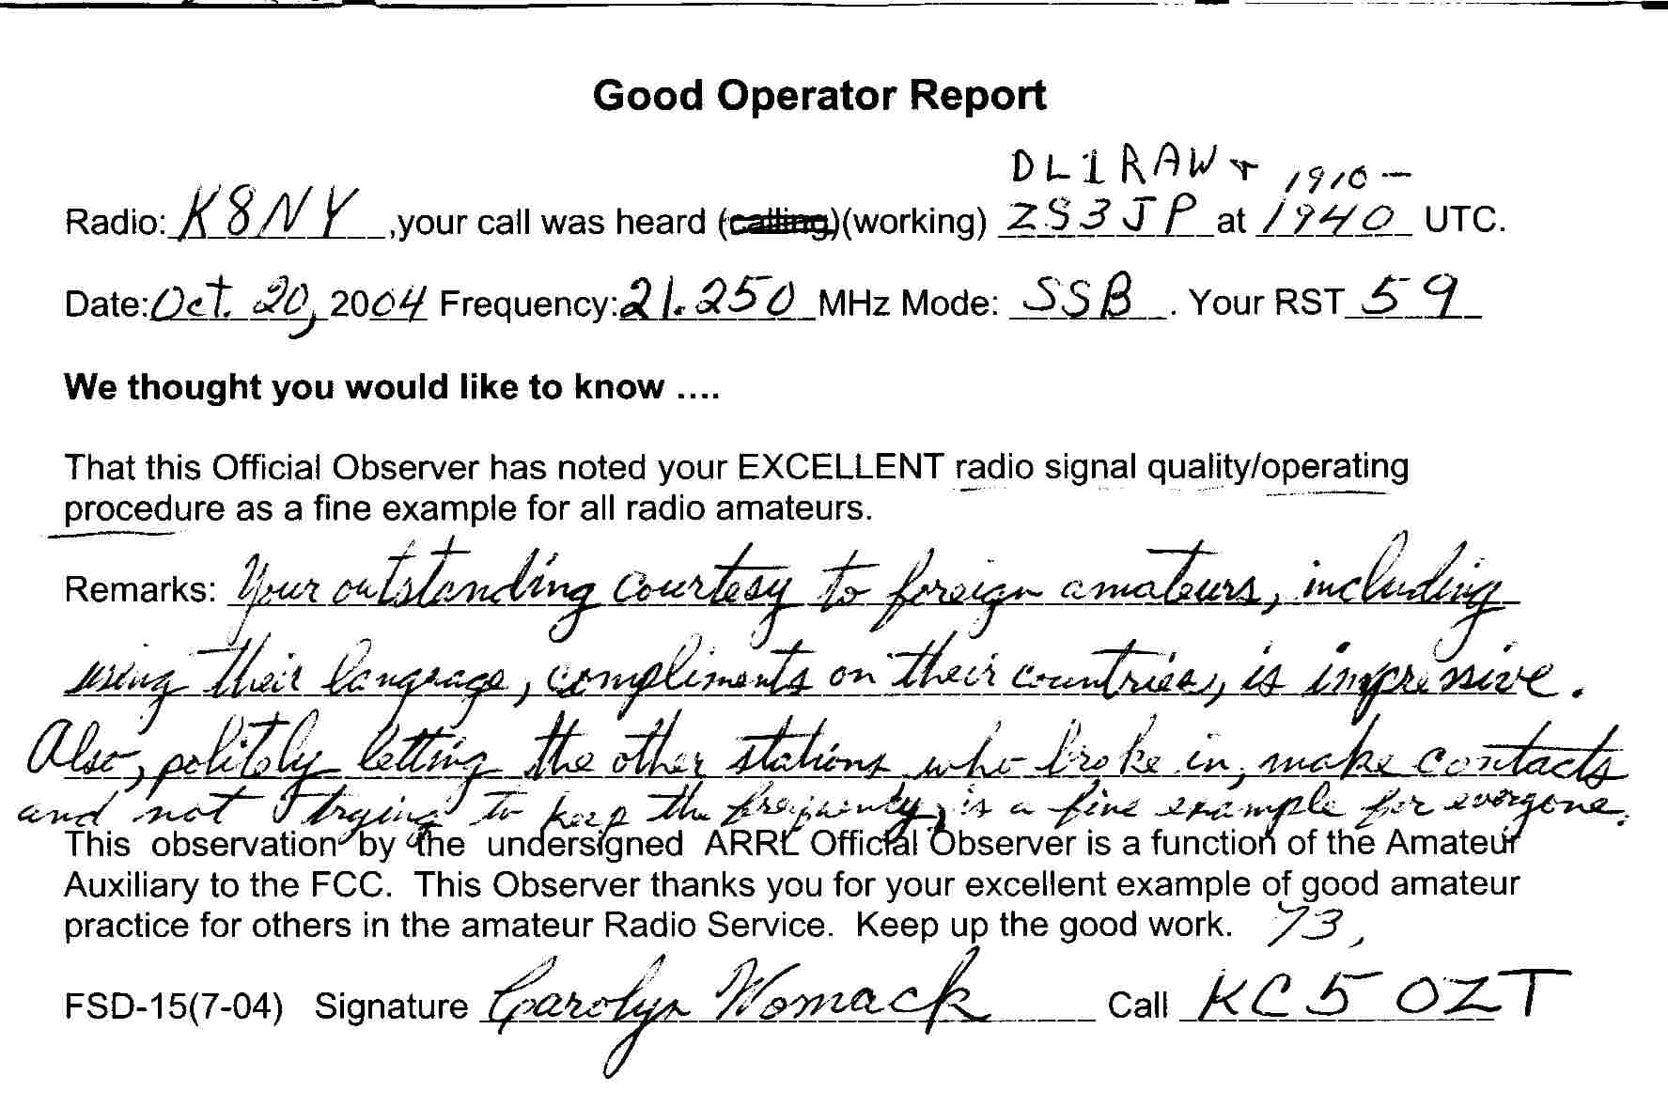
Volunteer Monitoring Program
Composed of ARRL volunteer-appointees, the VMP was created to assist the FCC
Monitoring the bands
Notifying amateurs of technical and operating discrepancies (or complimenting good operation)
The mission of the VMP is to encourage self-regulation and compliance with the FCC rules

Slide 7
Volunteer Monitoring Program
In cases involving serious rule violations, such as malicious interference, the VMP is trained and certified to gather and forward evidence that can be used by the FCC in enforcement actions
Transmitters (repeaters) stuck on (next slide)
Defective equipment (amateur or not)
Noise sources
Jamming or deceptive signals

Slide 8
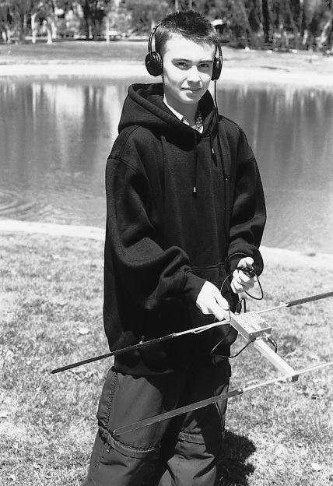
Fox Hunting
Transmitter Hunting (Fox Hunting)
Very popular Amateur Radio club activity
Competitive radiosport events (especially in Europe)
Hand-held directional antennas used to find hidden transmitters
Direction finding and beam heading triangulation skills are used by members of the Volunteer Monitoring Program to locate stations violating FCC rules, continuous carriers, or stations in distress

Slide 9
Federal Aviation Admin Rules
Amateurs who plan to construct an antenna structure more than 200 feet in height must notify the FAA and register the tower with the FCC
Additional restrictions may apply if the antenna is within 4 miles of a public use airport or heliport

Slide 10
More On Towers
Local building codes may also impact tower plans.
FCC Rule PRB-1 states that Amateur Radio communications must be reasonably accommodated. Any regulations must be the minimum practical and have a legitimate purpose.

Slide 11
Take Quiz 1

Slide 12
G1B01 - What is the maximum height above ground for an antenna structure not near a public use airport without requiring notification to the FAA and registration with the FCC?
A. 50 feet
B. 100 feet
C. 200 feet
D. 250 feet

Slide 13
G1B01 - What is the maximum height above ground for an antenna structure not near a public use airport without requiring notification to the FAA and registration with the FCC?
A. 50 feet
B. 100 feet
C. 200 feet
D. 250 feet

Slide 14
G1B06 - Under what conditions are state and local governments permitted to regulate amateur radio antenna structures?
A. Under no circumstances, FCC rules take priority
B. At any time and to any extent necessary to accomplish a legitimate purpose of the state or local entity, provided that proper filings are made with the FCC
C. Only when such structures exceed 50 feet in height and are clearly visible 1,000 feet from the structure
D. Amateur Service communications must be reasonably accommodated, and regulations must constitute the minimum practical to accommodate a legitimate purpose of the state or local entity

Slide 15
G1B06 - Under what conditions are state and local governments permitted to regulate amateur radio antenna structures?
A. Under no circumstances, FCC rules take priority
B. At any time and to any extent necessary to accomplish a legitimate purpose of the state or local entity, provided that proper filings are made with the FCC
C. Only when such structures exceed 50 feet in height and are clearly visible 1,000 feet from the structure
D. Amateur Service communications must be reasonably accommodated, and regulations must constitute the minimum practical to accommodate a legitimate purpose of the state or local entity

Slide 16
G1D05 - When operating a US station by remote control from outside the country, what license is required of the control operator?
A. A US operator/primary station license
B. Only an appropriate US operator/primary license and a special remote station permit from the FCC
C. Only a license from the foreign country, as long as the call sign includes identification of portable operation in the US
D. A license from the foreign country and a special remote station permit from the FCC

Slide 17
G1D05 - When operating a US station by remote control from outside the country, what license is required of the control operator?
A. A US operator/primary station license
B. Only an appropriate US operator/primary license and a special remote station permit from the FCC
C. Only a license from the foreign country, as long as the call sign includes identification of portable operation in the US
D. A license from the foreign country and a special remote station permit from the FCC

Slide 18
G1D12 - When operating a station in South America by remote control over the internet from the US, what regulations apply?
A. Those of both the remote station's country and the FCC
B. Those of the remote station's country and the FCC's third-party regulations
C. Only those of the remote station's country
D. Only those of the FCC

Slide 19
G1D12 - When operating a station in South America by remote control over the internet from the US, what regulations apply?
A. Those of both the remote station's country and the FCC
B. Those of the remote station's country and the FCC's third-party regulations
C. Only those of the remote station's country
D. Only those of the FCC

Slide 20
G1E06 - The frequency allocations of which ITU region apply to radio amateurs operating in North and South America?
A. Region 4
B. Region 3
C. Region 2
D. Region 1

Slide 21
G1E06 - The frequency allocations of which ITU region apply to radio amateurs operating in North and South America?
A. Region 4
B. Region 3
C. Region 2
D. Region 1

Slide 22
G2D01 - What is the Volunteer Monitor Program?
A. Amateur volunteers who are formally enlisted to monitor the airwaves for rules violations
B. Amateur volunteers who conduct amateur licensing examinations
C. Amateur volunteers who conduct frequency coordination for amateur VHF repeaters
D. Amateur volunteers who use their station equipment to help civil defense organizations in times of emergency

Slide 23
G2D01 - What is the Volunteer Monitor Program?
A. Amateur volunteers who are formally enlisted to monitor the airwaves for rules violations
B. Amateur volunteers who conduct amateur licensing examinations
C. Amateur volunteers who conduct frequency coordination for amateur VHF repeaters
D. Amateur volunteers who use their station equipment to help civil defense organizations in times of emergency

Slide 24
G2D02 - Which of the following are objectives of the Volunteer Monitor Program?
A. To conduct efficient and orderly amateur licensing examinations
B. To provide emergency and public safety communications
C. To coordinate repeaters for efficient and orderly spectrum usage
D. To encourage amateur radio operators to self-regulate and comply with the rules

Slide 25
G2D02 - Which of the following are objectives of the Volunteer Monitor Program?
A. To conduct efficient and orderly amateur licensing examinations
B. To provide emergency and public safety communications
C. To coordinate repeaters for efficient and orderly spectrum usage
D. To encourage amateur radio operators to self-regulate and comply with the rules

Slide 26
G2D03 - What procedure may be used by Volunteer Monitors to localize a station whose continuous carrier is holding a repeater on in their area?
A. Compare vertical and horizontal signal strengths on the input frequency
B. Compare beam headings on the repeater input from their home locations with that of other Volunteer Monitors
C. Compare signal strengths between the input and output of the repeater
D. All these choices are correct

Slide 27
G2D03 - What procedure may be used by Volunteer Monitors to localize a station whose continuous carrier is holding a repeater on in their area?
A. Compare vertical and horizontal signal strengths on the input frequency
B. Compare beam headings on the repeater input from their home locations with that of other Volunteer Monitors
C. Compare signal strengths between the input and output of the repeater
D. All these choices are correct

Slide 28
General License Course Chapter 3.2
Amateur Licensing Rules

Slide 29
License Elements
There are three license exams, which are called elements:
Element 2 – Technician class (35 multiple-choice questions) - You've already passed this!
Element 3 – General class (35 multiple-choice questions plus Element 2)
Element 4 – Amateur Extra class (50 multiple-choice questions plus Elements 2 and 3)
There is no longer an Element 1. Morse code was dropped as a licensing requirement.

Slide 30
Volunteer Examiner Rules
Must be accredited by a Volunteer Examiner Coordinator* (Fulton ARC uses W5YI – the other common VEC is the ARRL)
Must be at least 18 years of age
Must hold a General class or higher license and be in the FCC database
Must have never had your amateur license suspended or revoked
Non-U.S. citizen must hold an FCC-granted General class license or higher
General class VEs may administer ONLY the Element 2 Technician class exam
*VECs have an agreement to coordinate license exams for the FCC

Slide 31
Examination Rules
Rules are the same for all exam elements
Exam session must be coordinated by a VEC with each VE being accredited by that VEC
Exam session must be conducted by at least three VEs who grade all exams and are responsible for determining the correct answers
Each successful applicant is given a Certificate of Successful Completion of Examination (CSCE) — good for 365 days — indicating which element(s) the examinee passed

Slide 32
Identification Requirements
As soon as you upgrade and receive your CSCE you can start using all of your new (and old) privileges
Until your upgrade appears in the FCC database, append your call with the identifier (interim AG or /AG) whenever you operate using General Class frequency privileges.
Communicate in any language but identify in English or standard English language alphabet

Slide 33
License Expiration - Grace Period
Grace period is 2 years for renewing a lapsed license without re-testing
Beyond 2 years, a person having held an unrevoked, expired General class or higher license can get a new, equivalent license issued once they show proof of an expired license and pass the Technician class (element 2) license exam to insure they still understand the rules and regulations
No new Advanced class licenses will be issued
A new General class license will be issued to expired Generals or Advanced license holders
A new Extra class license will be issued to expired Extra license holders

Slide 34
Take Quiz 2

Slide 35
G1D01 - Who may receive partial credit for the elements represented by an expired amateur radio license?
A. Any person who can demonstrate that they once held an FCC-issued General, Advanced, or Amateur Extra class license that was not revoked by the FCC
B. Anyone who held an FCC-issued amateur radio license that expired not less than 5 and not more than 15 years ago
C. Any person who previously held an amateur license issued by another country, but only if that country has a current reciprocal licensing agreement with the FCC
D. Only persons who once held an FCC issued Novice, Technician, or Technician Plus license

Slide 36
G1D01 - Who may receive partial credit for the elements represented by an expired amateur radio license?
A. Any person who can demonstrate that they once held an FCC-issued General, Advanced, or Amateur Extra class license that was not revoked by the FCC
B. Anyone who held an FCC-issued amateur radio license that expired not less than 5 and not more than 15 years ago
C. Any person who previously held an amateur license issued by another country, but only if that country has a current reciprocal licensing agreement with the FCC
D. Only persons who once held an FCC issued Novice, Technician, or Technician Plus license

Slide 37
G1D02 - What license examinations may you administer as an accredited Volunteer Examiner holding a General class operator license?
A. General and Technician
B. None, only Amateur Extra class licensees may be accredited
C. Technician only
D. Amateur Extra, General, and Technician

Slide 38
G1D02 - What license examinations may you administer as an accredited Volunteer Examiner holding a General class operator license?
A. General and Technician
B. None, only Amateur Extra class licensees may be accredited
C. Technician only
D. Amateur Extra, General, and Technician

Slide 39
G1D03 - On which of the following band segments may you operate if you are a Technician class operator and have an unexpired Certificate of Successful Completion of Examination (CSCE) for General class privileges?
A. Only the Technician band segments until your upgrade is posted in the FCC database
B. Only on the Technician band segments until you have a receipt for the FCC application fee payment
C. On any General or Technician class band segment
D. On any General or Technician class band segment except 30 meters and 60 meters

Slide 40
G1D03 - On which of the following band segments may you operate if you are a Technician class operator and have an unexpired Certificate of Successful Completion of Examination (CSCE) for General class privileges?
A. Only the Technician band segments until your upgrade is posted in the FCC database
B. Only on the Technician band segments until you have a receipt for the FCC application fee payment
C. On any General or Technician class band segment
D. On any General or Technician class band segment except 30 meters and 60 meters

Slide 41
G1D04 - Who must observe the administration of a Technician class license examination?
A. At least three Volunteer Examiners of General class or higher
B. At least two Volunteer Examiners of General class or higher
C. At least two Volunteer Examiners of Technician class or higher
D. At least three Volunteer Examiners of Technician class

Slide 42
G1D04 - Who must observe the administration of a Technician class license examination?
A. At least three Volunteer Examiners of General class or higher
B. At least two Volunteer Examiners of General class or higher
C. At least two Volunteer Examiners of Technician class or higher
D. At least three Volunteer Examiners of Technician class

Slide 43
G1D06 - Until an upgrade to General class is shown in the FCC database, when must a Technician licensee identify with "AG" after their call sign?
A. Whenever they operate using General class frequency privileges
B. Whenever they operate on any amateur frequency
C. Whenever they operate using Technician frequency privileges
D. A special identifier is not required if their General class license application has been filed with the FCC

Slide 44
G1D06 - Until an upgrade to General class is shown in the FCC database, when must a Technician licensee identify with "AG" after their call sign?
A. Whenever they operate using General class frequency privileges
B. Whenever they operate on any amateur frequency
C. Whenever they operate using Technician frequency privileges
D. A special identifier is not required if their General class license application has been filed with the FCC

Slide 45
G1D07 - Volunteer Examiners are accredited by what organization?
A. The Federal Communications Commission
B. The Universal Licensing System
C. A Volunteer Examiner Coordinator
D. The Wireless Telecommunications Bureau

Slide 46
G1D07 - Volunteer Examiners are accredited by what organization?
A. The Federal Communications Commission
B. The Universal Licensing System
C. A Volunteer Examiner Coordinator
D. The Wireless Telecommunications Bureau

Slide 47
G1D08 - Which of the following criteria must be met for a non-US citizen to be an accredited Volunteer Examiner?
A. The person must be a resident of the US for a minimum of 5 years
B. The person must hold an FCC granted amateur radio license of General class or above
C. The person's home citizenship must be in ITU region 2
D. None of these choices is correct; a non-US citizen cannot be a Volunteer Examiner

Slide 48
G1D08 - Which of the following criteria must be met for a non-US citizen to be an accredited Volunteer Examiner?
A. The person must be a resident of the US for a minimum of 5 years
B. The person must hold an FCC granted amateur radio license of General class or above
C. The person's home citizenship must be in ITU region 2
D. None of these choices is correct; a non-US citizen cannot be a Volunteer Examiner

Slide 49
G1D09 - How long is a Certificate of Successful Completion of Examination (CSCE) valid for exam element credit?
A. 30 days
B. 180 days
C. 365 days
D. For as long as your current license is valid

Slide 50
G1D09 - How long is a Certificate of Successful Completion of Examination (CSCE) valid for exam element credit?
A. 30 days
B. 180 days
C. 365 days
D. For as long as your current license is valid

Slide 51
G1D10 - What is the minimum age that one must be to qualify as an accredited Volunteer Examiner?
A. 16 years
B. 18 years
C. 21 years
D. There is no age limit

Slide 52
G1D10 - What is the minimum age that one must be to qualify as an accredited Volunteer Examiner?
A. 16 years
B. 18 years
C. 21 years
D. There is no age limit

Slide 53
G1D11 - What action is required to obtain a new General class license after a previously held license has expired and the two-year grace period has passed?
A. They must have a letter from the FCC showing they once held an amateur or commercial license
B. There are no requirements other than being able to show a copy of the expired license
C. Contact the FCC to have the license reinstated
D. The applicant must show proof of the appropriate expired license grant and pass the current Element 2 exam

Slide 54
G1D11 - What action is required to obtain a new General class license after a previously held license has expired and the two-year grace period has passed?
A. They must have a letter from the FCC showing they once held an amateur or commercial license
B. There are no requirements other than being able to show a copy of the expired license
C. Contact the FCC to have the license reinstated
D. The applicant must show proof of the appropriate expired license grant and pass the current Element 2 exam

Slide 55
General License Course Chapter 3.3
Control Operator Privileges and Rules

Slide 56
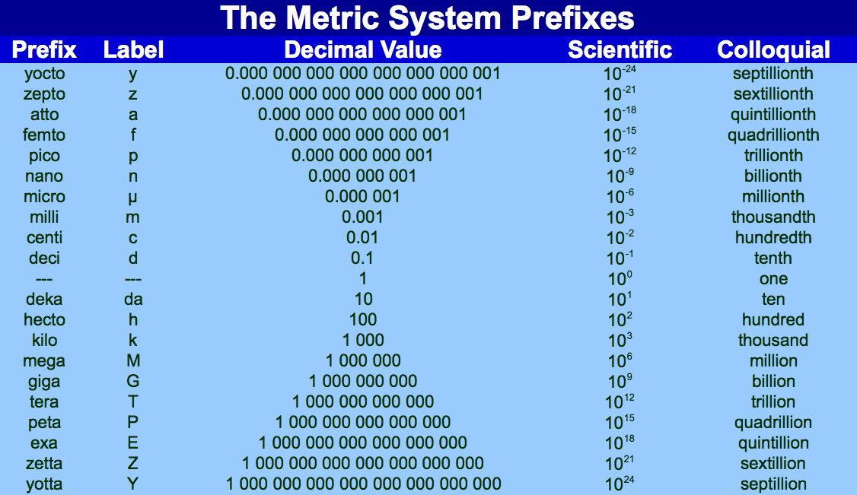
But First: Metric Prefixes!
...and Frequency vs. wavelength...

Slide 57
Frequency Privileges
“Traditional” amateur band frequency sequence: 1.8, 3.5, 7, 14, 21, 28 MHz
Convert frequency to wavelength: 300/f (f = frequency in MHz)
“Traditional” band wavelengths are therefore: 160, 80/75, 40, 20, 15, and 10 meters (1 meter = 39.37 inches)
WARC* amateur bands: 60, 30, 17, 12 meters
General class license operators have some privileges on all bands
When General Class licensees are not permitted to use the entire voice portion of a particular band, the permitted frequencies are generally at the upper frequency portion (top end) of the band.
*World Administrative Radio Conference

Slide 58
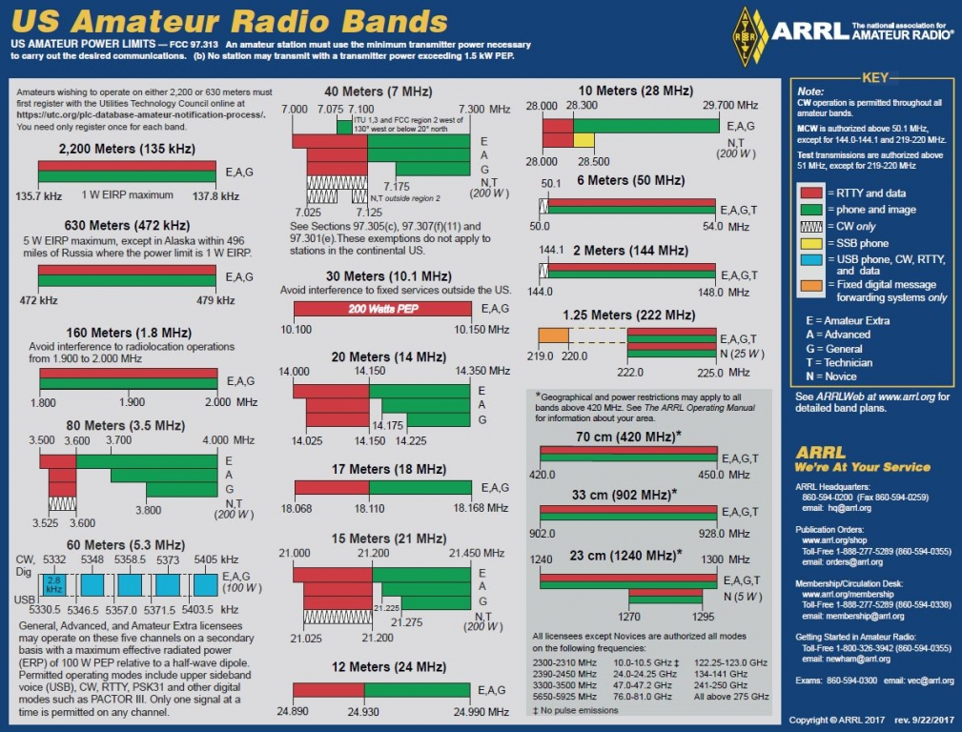
Frequency Privileges
More Privileges = More Responsibility

Slide 59
Frequency Privileges
Special notes about the 80, 40, 20 and 15 meter bands:
There are portions where General class licensees cannot transmit
There are segments exclusively allocated to Amateur Extra class licensees

Slide 60
Frequency Privileges
A General Class license holder is granted ALL amateur frequency privileges on the following six HF bands:
160 meters
60 meters (5 specific channels, 100w ERP referenced to a dipole antenna)
30 meters (phone/image transmission prohibited, 200w)
17 meters
12 meters
10 meters

Slide 61
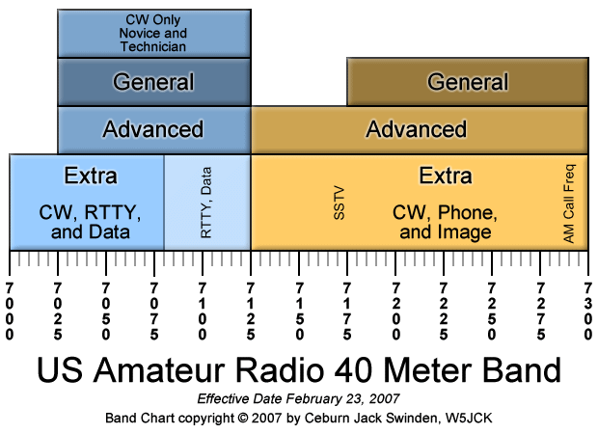
Commission’s Rules
General class control operator frequency privileges
7.250 MHz is a frequency in the General Class portion of the 40-meter band.
General class licensees are NOT permitted to be control operators outside of their privileges (example: 7.125-7.175 MHz)
Watch the units! 1 MHz = 1,000 kHz = 1,000,000 Hz

Slide 62
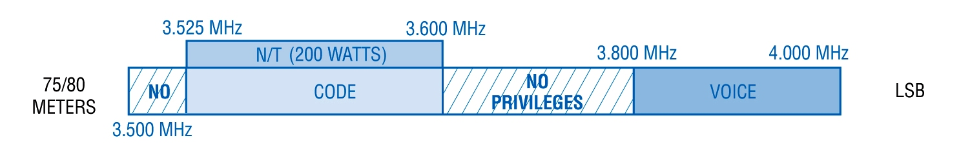
Commission’s Rules
A frequency of 3,900 kHz is within the General Class portion of the 75 meter band.
3900 kHz
Notice areas where there are no privileges for General Class.
Generally on this band:
phone operation is called 75 meters; CW operation is called 80 meters.

Slide 63
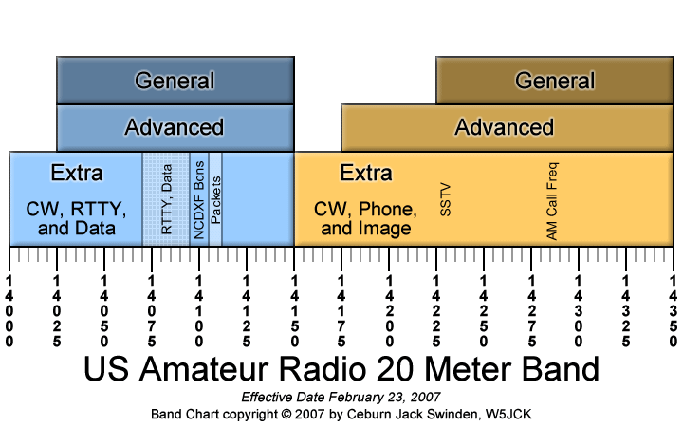
Commission’s Rules
General class control operator frequency privileges
14,305 kHz is a frequency within the General class portion of the 20-meter phone band.

Slide 64
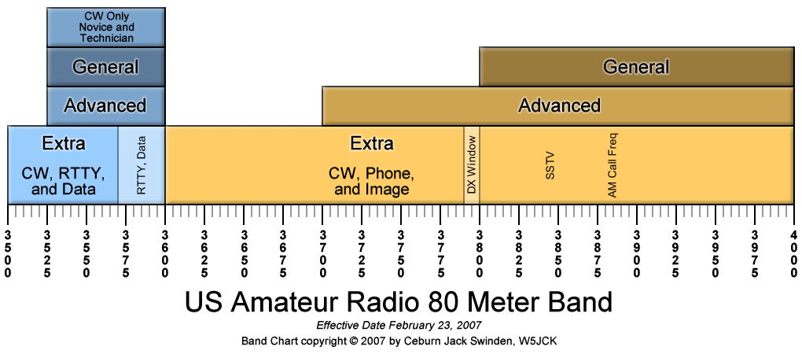
Commission’s Rules
General class control operator frequency privileges
3560 kHz is a frequency within the General class portion of the 80-meter band.

Slide 65
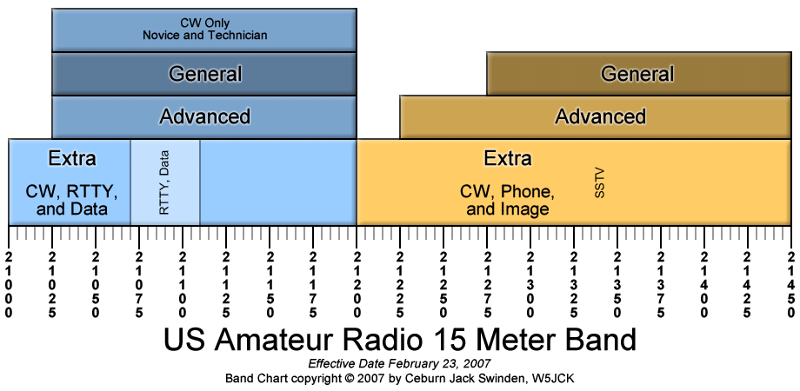
Commission’s Rules
General class control operator frequency privileges
21,300 kHz is a frequency within the General class portion of the 15-meter phone band.

Slide 66
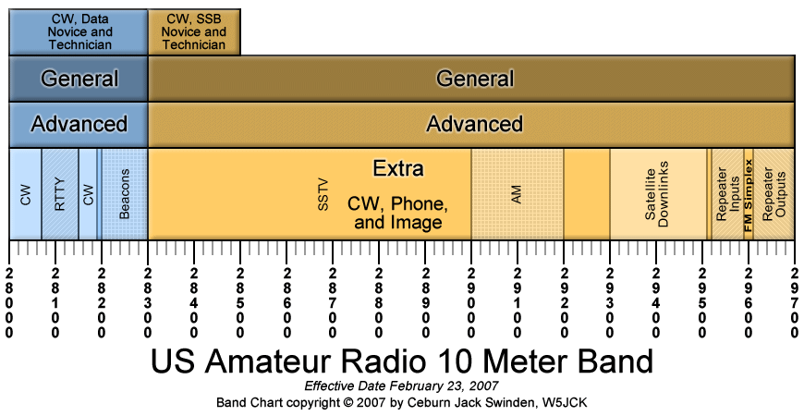
Commission’s Rules
General class control operator frequency privileges
ALL 10 meter frequencies are available to a control
operator holding a General Class License:
28.020 MHz 28.350 MHz 28.550 MHz
Remember: CW emissions are permitted on ANY General Class frequency.

Slide 67
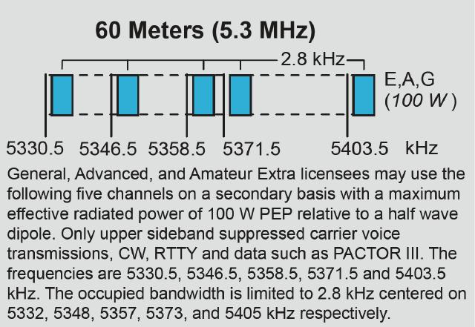
60 Meters is Unique...

Slide 68
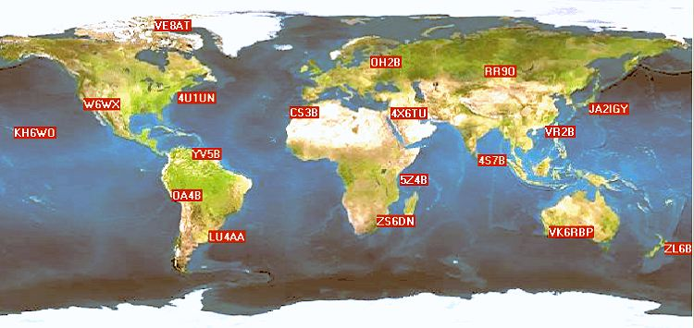
World Wide Beacon Network
Picture from the NCDXF: www.ncdxf.org/beacons

Slide 69
Beacons
Beacons help determine when band openings occur
Northern California DX Foundation operates and maintains CW beacons on 14.100, 18.110, 21.150, 24.930 and 28.200 MHz (www.ncdxf.org/beacons)
Use of these frequencies should be avoided

Slide 70
Beacons – Briefly…
Each beacon transmits CW every three minutes, day and night. A transmission consists of the callsign of the beacon sent at 22 words per minute followed by four one-second dashes. The callsign and the first dash are sent at 100 watts. The remaining dashes are sent at 10 watts, 1 watt and 100 milliwatts. The table that follows gives the minute and second of the start of the first transmission within the hour for each beacon on each frequency.

Slide 71
Call Location 14.100 18.110 21.150 24.930 28.200
4U1UN United Nations 00:00 00:10 00:20 00:30 00:40
VE8AT Canada 00:10 00:20 00:30 00:40 00:50
W6WX United States 00:20 00:30 00:40 00:50 01:00
KH6WO Hawaii 00:30 00:40 00:50 01:00 01:10
ZL6B New Zealand 00:40 00:50 01:00 01:10 01:20
VK6RBP Australia 00:50 01:00 01:10 01:20 01:30
JA2IGY Japan 01:00 01:10 01:20 01:30 01:40
RR9O Russia 01:10 01:20 01:30 01:40 01:50
VR2B Hong Kong 01:20 01:30 01:40 01:50 02:00 4S7B Sri Lanka 01:30 01:40 01:50 02:00 02:10
ZS6DN South Africa 01:40 01:50 02:00 02:10 02:20
5Z4B Kenya 01:50 02:00 02:10 02:20 02:30
4X6TU Israel 02:00 02:10 02:20 02:30 02:40
OH2B Finland 02:10 02:20 02:30 02:40 02:50
CS3B Madeira 02:20 02:30 02:40 02:50 00:00
LU4AA Argentina 02:30 02:40 02:50 00:00 00:10
OA4B Peru 02:40 02:50 00:00 00:10 00:20
YV5B Venezuela 02:50 00:00 00:10 00:20 00:30

Slide 72
C:\Users\ai2n\Videos\General Course - Videos\4X6TU_15m_Beacon.wmv
4X6TU Beacon – 15 meters

Slide 73
Beacons
Beacons are used for observation of propagation and reception to various parts of the world (as identified in FCC rules)
No more than one beacon signal in the same band from a single location is permitted
Beacons are limited to 100 W PEP
28.2 to 28.3 MHz is the only HF band segment where automatically controlled beacons may operate

Slide 74
Repeater Coordination
Volunteer Repeater or Frequency Coordinators are established to minimize repeater-to-repeater interference
Regional Coordinators work with local amateurs to assign input and output frequencies to minimize interference
HF Repeater operation is limited to the 10 meter band above 29.5 MHz

Slide 75
Commission’s Rules - Interference
Conditions that require an Amateur Radio station to take specific steps to avoid harmful interference to other users or facilities
When operating within one mile of an FCC Monitoring Station
When using a band where the Amateur Service is secondary
When a station is transmitting spread spectrum emissions
All of these choices are correct
In the event of interference between a coordinated repeater and an uncoordinated repeater, the licensee of the non-coordinated repeater has primary responsibility to resolve the interference.

Slide 76
Primary vs. Secondary
Amateurs have primary status on most bands
Exceptions: On 60 meters, 30 meters, and 70 cm amateurs have secondary status
When operating on a secondary allocated band, listen carefully to prevent interference to the primary service
If necessary, change frequency or stop transmitting to avoid interference - you are not protected from interference by primary users

Slide 77
WiFi Considerations
Amateur Radio shares spectrum with unlicensed Wi-fi devices in the 13 cm (2.4 GHz) band
Amateurs may use some Wi-Fi protocols on this band but communicating with non-licensed Wi-Fi stations/routers is prohibited

Slide 78
Take Quiz 3

Slide 79
G1A01 - On which HF and/or MF amateur bands are there portions where General class licensees cannot transmit?
A. 60 meters, 30 meters, 17 meters, and 12 meters
B. 160 meters, 60 meters, 15 meters, and 12 meters
C. 80 meters, 40 meters, 20 meters, and 15 meters
D. 80 meters, 20 meters, 15 meters, and 10 meters

Slide 80
G1A01 - On which HF and/or MF amateur bands are there portions where General class licensees cannot transmit?
A. 60 meters, 30 meters, 17 meters, and 12 meters
B. 160 meters, 60 meters, 15 meters, and 12 meters
C. 80 meters, 40 meters, 20 meters, and 15 meters
D. 80 meters, 20 meters, 15 meters, and 10 meters

Slide 81
G1A02 - On which of the following bands is phone operation prohibited?
A. 160 meters
B. 30 meters
C. 17 meters
D. 12 meters

Slide 82
G1A02 - On which of the following bands is phone operation prohibited?
A. 160 meters
B. 30 meters
C. 17 meters
D. 12 meters

Slide 83
G1A03 - On which of the following bands is image transmission prohibited?
A. 160 meters
B. 30 meters
C. 20 meters
D. 12 meters

Slide 84
G1A03 - On which of the following bands is image transmission prohibited?
A. 160 meters
B. 30 meters
C. 20 meters
D. 12 meters

Slide 85
G1A04 - Which of the following amateur bands is restricted to communication only on specific channels, rather than frequency ranges?
A. 11 meters
B. 12 meters
C. 30 meters
D. 60 meters

Slide 86
G1A04 - Which of the following amateur bands is restricted to communication only on specific channels, rather than frequency ranges?
A. 11 meters
B. 12 meters
C. 30 meters
D. 60 meters

Slide 87
G1A05 - On which of the following frequencies are General class licensees prohibited from operating as control operator?
A. 7.125 MHz to 7.175 MHz
B. 28.000 MHz to 28.025 MHz
C. 21.275 MHz to 21.300 MHz
D. All of the above

Slide 88
G1A05 - On which of the following frequencies are General class licensees prohibited from operating as control operator?
A. 7.125 MHz to 7.175 MHz
B. 28.000 MHz to 28.025 MHz
C. 21.275 MHz to 21.300 MHz
D. All of the above

Slide 89
G1A06 - Which of the following applies when the FCC rules designate the amateur service as a secondary user on a band?
A. Amateur stations must record the call sign of the primary service station before operating on a frequency assigned to that station
B. Amateur stations may use the band only during emergencies
C. Amateur stations must not cause harmful interference to primary users and must accept interference from primary users
D. Amateur stations may only operate during specific hours of the day, while primary users are permitted 24-hour use of the band

Slide 90
G1A06 - Which of the following applies when the FCC rules designate the amateur service as a secondary user on a band?
A. Amateur stations must record the call sign of the primary service station before operating on a frequency assigned to that station
B. Amateur stations may use the band only during emergencies
C. Amateur stations must not cause harmful interference to primary users and must accept interference from primary users
D. Amateur stations may only operate during specific hours of the day, while primary users are permitted 24-hour use of the band

Slide 91
G1A07 - On which amateur frequencies in the 10-meter band may stations with a General class control operator transmit CW emissions?
A. 28.000 MHz to 28.025 MHz only
B. 28.000 MHz to 28.300 MHz only
C. 28.025 MHz to 28.300 MHz only
D. The entire band

Slide 92
G1A07 - On which amateur frequencies in the 10-meter band may stations with a General class control operator transmit CW emissions?
A. 28.000 MHz to 28.025 MHz only
B. 28.000 MHz to 28.300 MHz only
C. 28.025 MHz to 28.300 MHz only
D. The entire band

Slide 93
G1A08 - Which HF bands have segments exclusively allocated to Amateur Extra licensees?
A. All HF bands
B. 80 meters, 40 meters, 20 meters, and 15 meters
C. All HF bands except 160 meters and 10 meters
D. 60 meters, 30 meters, 17 meters, and 12 meters

Slide 94
G1A08 - Which HF bands have segments exclusively allocated to Amateur Extra licensees?
A. All HF bands
B. 80 meters, 40 meters, 20 meters, and 15 meters
C. All HF bands except 160 meters and 10 meters
D. 60 meters, 30 meters, 17 meters, and 12 meters

Slide 95
G1A09 - Which of the following frequencies is within the General class portion of the 15-meter band?
A. 14250 kHz
B. 18155 kHz
C. 21300 kHz
D. 24900 kHz

Slide 96
G1A09 - Which of the following frequencies is within the General class portion of the 15-meter band?
A. 14250 kHz
B. 18155 kHz
C. 21300 kHz
D. 24900 kHz

Slide 97
G1A10 - What portion of the 10-meter band is available for repeater use?
A. The entire band
B. The portion between 28.1 MHz and 28.2 MHz
C. The portion between 28.3 MHz and 28.5 MHz
D. The portion above 29.5 MHz

Slide 98
G1A10 - What portion of the 10-meter band is available for repeater use?
A. The entire band
B. The portion between 28.1 MHz and 28.2 MHz
C. The portion between 28.3 MHz and 28.5 MHz
D. The portion above 29.5 MHz

Slide 99
G1A11 - When General class licensees are not permitted to use the entire voice portion of a band, which portion of the voice segment is available to them?
A. The lower frequency portion
B. The upper frequency portion
C. The lower frequency portion on frequencies below 7.3 MHz, and the upper portion on frequencies above 14.150 MHz
D. The upper frequency portion on frequencies below 7.3 MHz, and the lower portion on frequencies above 14.150 MHz

Slide 100
G1A11 - When General class licensees are not permitted to use the entire voice portion of a band, which portion of the voice segment is available to them?
A. The lower frequency portion
B. The upper frequency portion
C. The lower frequency portion on frequencies below 7.3 MHz, and the upper portion on frequencies above 14.150 MHz
D. The upper frequency portion on frequencies below 7.3 MHz, and the lower portion on frequencies above 14.150 MHz

Slide 101
G1B02 - With which of the following conditions must beacon stations comply?
A. No more than one beacon station may transmit in the same band from the same station location
B. The frequency must be coordinated with the National Beacon Organization
C. The frequency must be posted on the internet or published in a national periodical
D. All these choices are correct

Slide 102
G1B02 - With which of the following conditions must beacon stations comply?
A. No more than one beacon station may transmit in the same band from the same station location
B. The frequency must be coordinated with the National Beacon Organization
C. The frequency must be posted on the internet or published in a national periodical
D. All these choices are correct

Slide 103
G1B03 - Which of the following is a purpose of a beacon station as identified in the FCC rules?
A. Observation of propagation and reception
B. Automatic identification of repeaters
C. Transmission of bulletins of general interest to amateur radio licensees
D. All these choices are correct

Slide 104
G1B03 - Which of the following is a purpose of a beacon station as identified in the FCC rules?
A. Observation of propagation and reception
B. Automatic identification of repeaters
C. Transmission of bulletins of general interest to amateur radio licensees
D. All these choices are correct

Slide 105
G1B09 - On what HF frequencies are automatically controlled beacons permitted?
A. On any frequency if power is less than 1 watt
B. On any frequency if transmissions are in Morse code
C. 21.08 MHz to 21.09 MHz
D. 28.20 MHz to 28.30 MHz

Slide 106
G1B09 - On what HF frequencies are automatically controlled beacons permitted?
A. On any frequency if power is less than 1 watt
B. On any frequency if transmissions are in Morse code
C. 21.08 MHz to 21.09 MHz
D. 28.20 MHz to 28.30 MHz

Slide 107
G1B10 - What is the power limit for beacon stations?
A. 10 watts PEP output
B. 20 watts PEP output
C. 100 watts PEP output
D. 200 watts PEP output

Slide 108
G1B10 - What is the power limit for beacon stations?
A. 10 watts PEP output
B. 20 watts PEP output
C. 100 watts PEP output
D. 200 watts PEP output

Slide 109
G1E04 - Which of the following conditions require a licensed amateur radio operator to take specific steps to avoid harmful interference to other users or facilities?
A. When operating within one mile of an FCC Monitoring Station
B. When using a band where the Amateur Service is secondary
C. When a station is transmitting spread spectrum emissions
D. All these choices are correct

Slide 110
G1E04 - Which of the following conditions require a licensed amateur radio operator to take specific steps to avoid harmful interference to other users or facilities?
A. When operating within one mile of an FCC Monitoring Station
B. When using a band where the Amateur Service is secondary
C. When a station is transmitting spread spectrum emissions
D. All these choices are correct

Slide 111
G1E07 - In what part of the 2.4 GHz band may an amateur station communicate with non-licensed Wi-Fi stations?
A. Anywhere in the band
B. Channels 1 through 4
C. Channels 42 through 45
D. No part

Slide 112
G1E07 - In what part of the 2.4 GHz band may an amateur station communicate with non-licensed Wi-Fi stations?
A. Anywhere in the band
B. Channels 1 through 4
C. Channels 42 through 45
D. No part

Slide 113
G1E10 - Why should an amateur operator normally avoid transmitting on 14.100, 18.110, 21.150, 24.930 and 28.200 MHz?
A. A system of propagation beacon stations operates on those frequencies
B. A system of automatic digital stations operates on those frequencies
C. These frequencies are set aside for emergency operations
D. These frequencies are set aside for bulletins from the FCC

Slide 114
G1E10 - Why should an amateur operator normally avoid transmitting on 14.100, 18.110, 21.150, 24.930 and 28.200 MHz?
A. A system of propagation beacon stations operates on those frequencies
B. A system of automatic digital stations operates on those frequencies
C. These frequencies are set aside for emergency operations
D. These frequencies are set aside for bulletins from the FCC

Slide 115
G8C01 - On what band do amateurs share channels with the unlicensed Wi-Fi service?
A. 432 MHz
B. 902 MHz
C. 2.4 GHz
D. 10.7 GHz

Slide 116
G8C01 - On what band do amateurs share channels with the unlicensed Wi-Fi service?
A. 432 MHz
B. 902 MHz
C. 2.4 GHz
D. 10.7 GHz

Slide 117
General License Course Chapter 3.3
Third Party, Prohibited, and
Restricted Communications

Slide 118
Permitted Transmissions
Occasional retransmission of weather and propagation forecasts from U.S. Government stations
One-Way transmissions to assist learning the International Morse Code

Slide 119
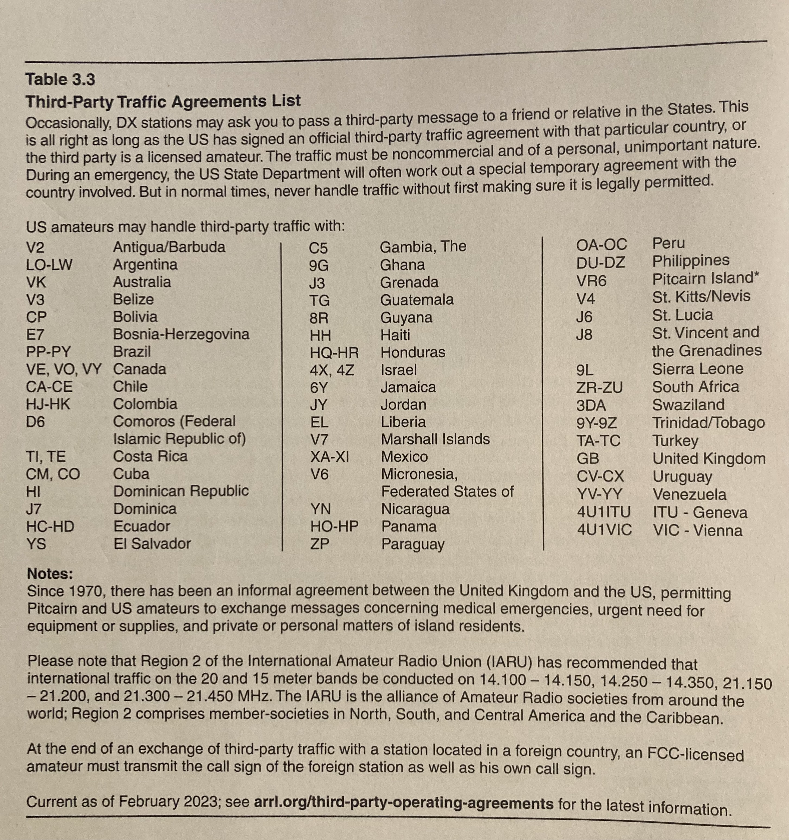
Third Party Traffic Agreements List

Slide 120
Prohibited & Restricted Communications
Music - except as part of manned space craft retransmissions
Transmissions of codes designed to obscure/hide the meaning of the message
Exceptions: controlling a space satellite or radio-controlled model craft
Transmitting false distress signals
Abbreviations or procedural signals are acceptable if they don't obscure the meaning of the message

Slide 121
Prohibited & Restricted Communications
Business-related or pecuniary (monetary) interests in communications activity. Exception: When other amateurs are being notified of the sale of apparatus normally used in an amateur station and such activity is not done on a regular basis (swap nets, etc.)
Amateur stations may communicate with amateurs in other countries except amateurs in countries whose administrations have notified the ITU that they object to such communications.

Slide 122
Prohibited & Restricted Communications
Restriction: A 10m to 2m cross-band repeater may only retransmit a 2m signal from a Technician class operator if the 10m control operator holds at least a General class license

Slide 123
Third-party communication - sending messages on behalf of someone who is not an amateur or allowing someone to speak on the radio who is not an amateur
If the third party was an amateur licensee whose license has been revoked and not reinstated he/she may NOT send a third-party message
Third-party communications may be exchanged between any two amateur stations with the constraint that the communications must be noncommercial and of a personal, unimportant nature or must be related to emergencies or disaster relief.
U.S. amateurs may conduct third-party amateur radio communication outside the U.S. ONLY if the country has a third-party agreement with the U.S.
EXCEPTION – Messages directly involving emergencies or disaster relief

Slide 124
Third-Party Communications
Third-Party messages may be transmitted via remote control under any circumstances in which third-party messages are permitted by FCC rules

Slide 125
Take Quiz 4

Slide 126
G1E01 - Which of the following would disqualify a third party from participating in sending a message via an amateur station?
A. The third party's amateur license has been revoked and not reinstated
B. The third party is not a US citizen
C. The third party is speaking in a language other than English
D. All these choices are correct

Slide 127
G1E01 - Which of the following would disqualify a third party from participating in sending a message via an amateur station?
A. The third party's amateur license has been revoked and not reinstated
B. The third party is not a US citizen
C. The third party is speaking in a language other than English
D. All these choices are correct

Slide 128
G1E05 - What are the restrictions on messages sent to a third party in a country with which there is a Third-Party Agreement?
A. They must relate to emergencies or disaster relief
B. They must be for other licensed amateurs
C. They must relate to amateur radio, or remarks of a personal character, or messages relating to emergencies or disaster relief
D. The message must be limited to no longer than 1 minute in duration and the name of the third party must be recorded in the station log

Slide 129
G1E05 - What are the restrictions on messages sent to a third party in a country with which there is a Third-Party Agreement?
A. They must relate to emergencies or disaster relief
B. They must be for other licensed amateurs
C. They must relate to amateur radio, or remarks of a personal character, or messages relating to emergencies or disaster relief
D. The message must be limited to no longer than 1 minute in duration and the name of the third party must be recorded in the station log

Slide 130
G1E12 - When may third-party messages be transmitted via remote control?
A. Under any circumstances in which third party messages are permitted by FCC rules
B. Under no circumstances except for emergencies
C. Only when the message is intended for licensed radio amateurs
D. Only when the message is intended for third parties in areas where licensing is controlled by the FCC

Slide 131
G1E12 - When may third-party messages be transmitted via remote control?
A. Under any circumstances in which third party messages are permitted by FCC rules
B. Under no circumstances except for emergencies
C. Only when the message is intended for licensed radio amateurs
D. Only when the message is intended for third parties in areas where licensing is controlled by the FCC

Slide 132
G1B04 - Which of the following transmissions is permitted for all amateur stations?
A. Unidentified transmissions of less than 10 seconds duration for test purposes only
B. Automatic retransmission of other amateur signals by any amateur station
C. Occasional retransmission of weather and propagation forecast information from US government stations
D. Encrypted messages, if not intended to facilitate a criminal act

Slide 133
G1B04 - Which of the following transmissions is permitted for all amateur stations?
A. Unidentified transmissions of less than 10 seconds duration for test purposes only
B. Automatic retransmission of other amateur signals by any amateur station
C. Occasional retransmission of weather and propagation forecast information from US government stations
D. Encrypted messages, if not intended to facilitate a criminal act

Slide 134
G1B05 - Which of the following one-way transmissions are permitted?
A. Unidentified test transmissions of less than 10 seconds in duration
B. Transmissions to assist with learning the International Morse code
C. Regular transmissions offering equipment for sale, if intended for amateur radio use
D. All these choices are correct

Slide 135
G1B05 - Which of the following one-way transmissions are permitted?
A. Unidentified test transmissions of less than 10 seconds in duration
B. Transmissions to assist with learning the International Morse code
C. Regular transmissions offering equipment for sale, if intended for amateur radio use
D. All these choices are correct

Slide 136
G1B07 - What are the restrictions on the use of abbreviations or procedural signals in the amateur service?
A. Only "Q" signals are permitted
B. They may be used if they do not obscure the meaning of a message
C. They are not permitted
D. They are limited to those expressly listed in Part 97 of the FCC rules

Slide 137
G1B07 - What are the restrictions on the use of abbreviations or procedural signals in the amateur service?
A. Only "Q" signals are permitted
B. They may be used if they do not obscure the meaning of a message
C. They are not permitted
D. They are limited to those expressly listed in Part 97 of the FCC rules

Slide 138
G1B08 - When is it permissible to communicate with amateur stations in countries outside the areas administered by the Federal Communications Commission?
A. Only when the foreign country has a formal third-party agreement filed with the FCC
B. When the contact is with amateurs in any country except those whose administrations have notified the ITU that they object to such communications
C. Only when the contact is with amateurs licensed by a country which is a member of the United Nations, or by a territory possessed by such a country
D. Only when the contact is with amateurs licensed by a country which is a member of the International Amateur Radio Union, or by a territory possessed by such a country

Slide 139
G1B08 - When is it permissible to communicate with amateur stations in countries outside the areas administered by the Federal Communications Commission?
A. Only when the foreign country has a formal third-party agreement filed with the FCC
B. When the contact is with amateurs in any country except those whose administrations have notified the ITU that they object to such communications
C. Only when the contact is with amateurs licensed by a country which is a member of the United Nations, or by a territory possessed by such a country
D. Only when the contact is with amateurs licensed by a country which is a member of the International Amateur Radio Union, or by a territory possessed by such a country

Slide 140
G1E02 - When may a 10-meter repeater retransmit the 2-meter signal from a station that has a Technician class control operator?
A. Under no circumstances
B. Only if the station on 10-meters is operating under a Special Temporary Authorization allowing such retransmission
C. Only during an FCC-declared general state of communications emergency
D. Only if the 10-meter repeater control operator holds at least a General class license

Slide 141
G1E02 - When may a 10-meter repeater retransmit the 2-meter signal from a station that has a Technician class control operator?
A. Under no circumstances
B. Only if the station on 10-meters is operating under a Special Temporary Authorization allowing such retransmission
C. Only during an FCC-declared general state of communications emergency
D. Only if the 10-meter repeater control operator holds at least a General class license

Slide 142
General License Course Chapter 3.4
Technical Rules and Standards

Slide 143
Good Amateur Practices
The general requirement by the FCC, in the absence of a specific rule, is that Amateur stations be operated in conformance with good engineering and good amateur practices
The FCC determines what good engineering or amateur practices are.
Allows a little wiggle room for experimentation

Slide 144
Transmitters & Power
FCC Rules dictate that Peak Envelope Power (PEP, in watts) will be used to describe/regulate maximum transmitter output power.
PEP will be described in more detail in a future lesson.

Slide 145
Transmitters & Power
General, Advanced and Amateur Extra operators are limited to a maximum transmitter output of 1500 W PEP - exceptions:
Amateurs are restricted to 200 W PEP on the 30m band
Amateurs are restricted to an ERP* of 100 watts PEP on 60m with a maximum bandwidth of 2.8 kHz
Amateurs are, at all times, required to use the minimum power necessary to carry out the desired communication
*Effective Radiated Power - includes power output, feedline loss, antenna gain - 100 W ERP assumes use of a dipole (0 dBd)

Slide 146
Transmitters & Power
QRP – low power transmit operation. Usually 10 W output power or less; 5 W is common. (Raise your power is QRO)
Some hams use even less power
Popular for portable operating
Novices and Techs are limited to 200 W PEP on HF
Spread Spectrum transmissions are limited to 10 W PEP

Slide 147
Commission’s Rules – Digital Modes
Baud - a unit of transmission speed equal to the number of times a signal changes state per second. Higher Baud rate = wider bandwidth
300 baud is the maximum symbol rate permitted for RTTY or data emission transmission on the 20 meter band.
300 baud is the maximum symbol rate permitted for RTTY or data emission transmitted at frequencies below 28 MHz.
1200 baud is the maximum symbol rate permitted for RTTY or data emission transmissions on the 10 meter band.
19.6 kilobaud is the maximum symbol rate permitted for RTTY or data emission transmissions on the 2 meter band.
56 kilobaud is the maximum symbol rate permitted for RTTY or data emission transmitted on the 1.25 meter and 70 centimeter bands.
THESE CHANGED! The FCC moved to bandwidth limits vs. data rate limits!

Slide 148
New Digital Protocols
New Digital Protocols are cropping up on a regular basis
Before using a new digital protocol LIVE on the air the FCC requires that the technical characteristics of the protocol be publicly documented
That can be as simple as publishing the protocols on a web page or in a magazine

Slide 149
Take Quiz 5

Slide 150
G1B11 - Who or what determines "good engineering and good amateur practice," as applied to the operation of an amateur station in all respects not covered by the Part 97 rules?
A. The FCC
B. The control operator
C. The IEEE
D. The ITU

Slide 151
G1B11 - Who or what determines "good engineering and good amateur practice," as applied to the operation of an amateur station in all respects not covered by the Part 97 rules?
A. The FCC
B. The control operator
C. The IEEE
D. The ITU

Slide 152
G1C01 - What is the maximum transmitter power an amateur station may use on 10.140 MHz?
A. 200 watts PEP output
B. 1000 watts PEP output
C. 1500 watts PEP output
D. 2000 watts PEP output

Slide 153
G1C01 - What is the maximum transmitter power an amateur station may use on 10.140 MHz?
A. 200 watts PEP output
B. 1000 watts PEP output
C. 1500 watts PEP output
D. 2000 watts PEP output

Slide 154
G1C02 - What is the maximum transmitter power an amateur station may use on the 12-meter band?
A. 50 watts PEP output
B. 200 watts PEP output
C. 1500 watts PEP output
D. An effective radiated power equivalent to 100 watts from a half-wave dipole

Slide 155
G1C02 - What is the maximum transmitter power an amateur station may use on the 12-meter band?
A. 50 watts PEP output
B. 200 watts PEP output
C. 1500 watts PEP output
D. An effective radiated power equivalent to 100 watts from a half-wave dipole

Slide 156
G1C03 - What is the maximum bandwidth permitted by FCC rules for amateur radio stations transmitting on USB frequencies in the 60-meter band?
A. 2.8 kHz
B. 5.6 kHz
C. 1.8 kHz
D. 3 kHz

Slide 157
G1C03 - What is the maximum bandwidth permitted by FCC rules for amateur radio stations transmitting on USB frequencies in the 60-meter band?
A. 2.8 kHz
B. 5.6 kHz
C. 1.8 kHz
D. 3 kHz

Slide 158
G1C05 - What is the limit for transmitter power on the 28 MHz band for a General Class control operator?
A. 100 watts PEP output
B. 1000 watts PEP output
C. 1500 watts PEP output
D. 2000 watts PEP output

Slide 159
G1C05 - What is the limit for transmitter power on the 28 MHz band for a General Class control operator?
A. 100 watts PEP output
B. 1000 watts PEP output
C. 1500 watts PEP output
D. 2000 watts PEP output

Slide 160
G1C06 - What is the limit for transmitter power on the 1.8 MHz band?
A. 200 watts PEP output
B. 1000 watts PEP output
C. 1200 watts PEP output
D. 1500 watts PEP output

Slide 161
G1C06 - What is the limit for transmitter power on the 1.8 MHz band?
A. 200 watts PEP output
B. 1000 watts PEP output
C. 1200 watts PEP output
D. 1500 watts PEP output

Slide 162
G1C09 - What is the maximum power limit on the 60-meter band?
A. 1500 watts PEP
B. 10 watts RMS
C. ERP of 100 watts PEP with respect to a dipole
D. ERP of 100 watts PEP with respect to an isotropic antenna

Slide 163
G1C09 - What is the maximum power limit on the 60-meter band?
A. 1500 watts PEP
B. 10 watts RMS
C. ERP of 100 watts PEP with respect to a dipole
D. ERP of 100 watts PEP with respect to an isotropic antenna

Slide 164
G1C11 - What measurement is specified by FCC rules that regulate maximum power?
A. RMS output from the transmitter
B. RMS input to the antenna
C. PEP input to the antenna
D. PEP output from the transmitter

Slide 165
G1C11 - What measurement is specified by FCC rules that regulate maximum power?
A. RMS output from the transmitter
B. RMS input to the antenna
C. PEP input to the antenna
D. PEP output from the transmitter

Slide 166
G1E08 - What is the maximum PEP output allowed for spread spectrum transmissions?
A. 100 milliwatts
B. 10 watts
C. 100 watts
D. 1500 watts

Slide 167
G1E08 - What is the maximum PEP output allowed for spread spectrum transmissions?
A. 100 milliwatts
B. 10 watts
C. 100 watts
D. 1500 watts

Slide 168
G2D10 - What is QRP operation?
A. Remote piloted model control
B. Low-power transmit operation
C. Transmission using Quick Response Protocol
D. Traffic relay procedure net operation

Slide 169
G2D10 - What is QRP operation?
A. Remote piloted model control
B. Low-power transmit operation
C. Transmission using Quick Response Protocol
D. Traffic relay procedure net operation

Slide 170
G1C07 - What must be done before using a new digital protocol on the air?
A. Type-certify equipment to FCC standards
B. Obtain an experimental license from the FCC
C. Publicly document the technical characteristics of the protocol
D. Submit a rule-making proposal to the FCC describing the codes and methods of the technique

Slide 171
G1C07 - What must be done before using a new digital protocol on the air?
A. Type-certify equipment to FCC standards
B. Obtain an experimental license from the FCC
C. Publicly document the technical characteristics of the protocol
D. Submit a rule-making proposal to the FCC describing the codes and methods of the technique

Slide 172
Next Week – Chapters 4.1 to 4.3
Review Metric Prefixes (Kilo, micro, etc…)
and bring your calculators

